Slide 1
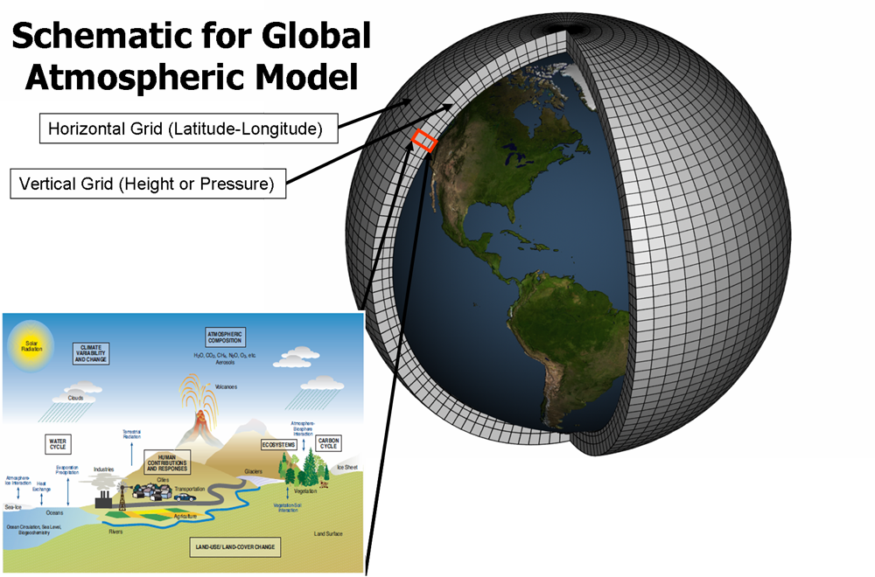
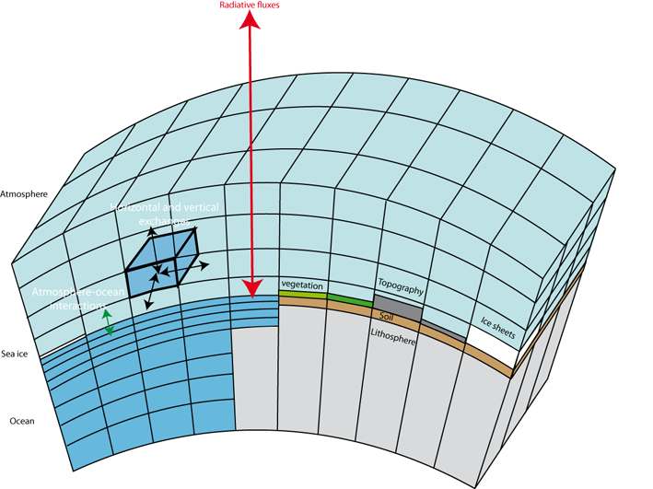
Climate models – what are they?
… and different grids for
different parts of the model:
atmosphere, ocean, land, ice,…

Slide 2
A bit of review: What do we need to make a model?
(Any model, not necessarily a climate one)
A good reference
Harris (2025) Atmospheric Modelling: Dynamics. https://doi.org/10.1016/B978-0-443-15748-6.00012-5

Slide 3
What does a model need? A very simple analytical example
Requires equations
(hypotheses about underlying physics)
Notes:
Equation of a line: C=lambda x t + beta

Slide 4
What does a model need? A very simple analytical example
Requires equations
(hypotheses about underlying physics)
What are they for climate?
Requires initial &
boundary conditions
+

Slide 5
What does a numerical model need? … a “dynamical/numerical core”. A very simple analytical example
Many equations cannot be solved analytically…
What do we have to do to solve them numerically?
…
i-2
i-1
i
i+1
i+2
…
Applies to time + 3D space

Slide 6
Discretization
Continuum
Discrete
(Taylor series expansion)
…
i-2
i-1
i
i+1
i+2
…
Applies to time + 3D space
In practice, this implies choices of Δx, Δy, Δz, Δt, size of the stencil, numerical stability, computational ability/costs, problem under study, etc.

Slide 7
What does a model need? A very simple numerical example
i
i+1
Requires discretization of derivatives
and numerical integration to step forward
from t_{i} to t_{f}=NΔT
Forward difference
(aka Forward Euler, an explicit scheme)
[climate models use more complex techniques]

Slide 8
What does a model need? Discretization needed to implement numerically
i
i+1
Backward difference
(aka backward Euler)
Requires solving an extra equation
(implicit scheme)

Slide 9
What does a model need? Discretization needed to implement numerically
i-1
i
i+1
Centered difference
Requires knowing more things from more points

Slide 10
The “dynamical/numerical core” of a model matters … a lot!
System of equation (partial differentials in 3D)
Discretization and integration scheme
These 3 are mathematically all valid but can produce very different answers when implemented…
Forward difference
(aka Forward Euler)
Backward difference
(aka backward Euler)
Centered difference
etc…

Slide 11
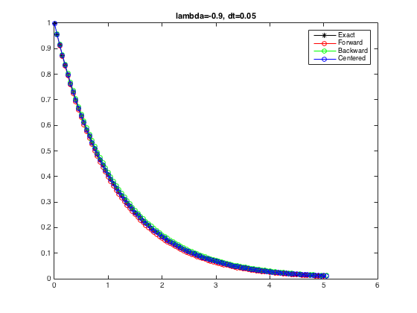
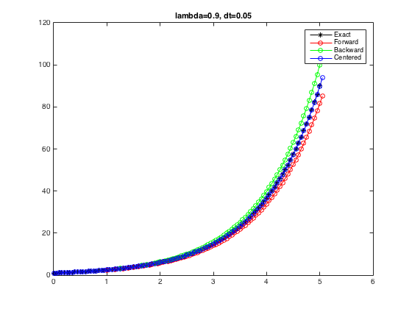
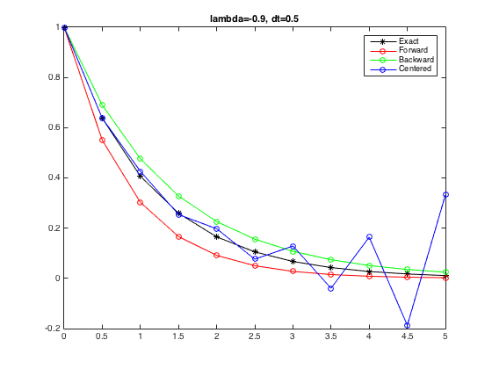
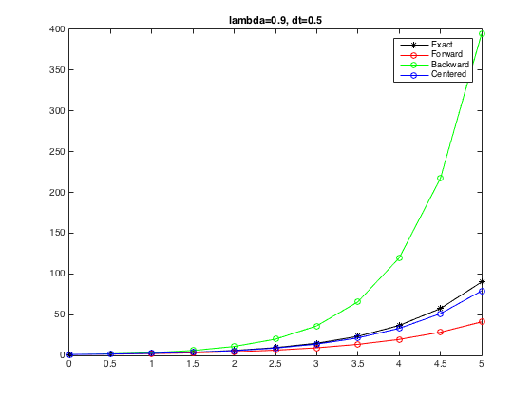
Δt=0.05
λ=-0.9
Δt=0.05
λ=0.9
Exact solution
Exact
Forward
Backward
Centered
Δt=0.5
λ=-0.9
Δt=0.5
λ=0.9
Exact
Forward
Backward
Centered

Slide 12
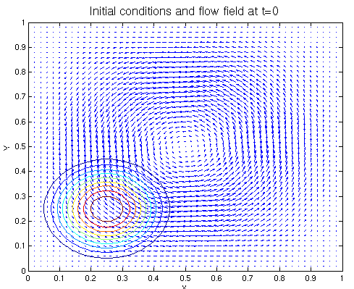
Testing the numerical core …when we don’t have an exact solution to compare to
Idealized simulations
~ numerical equivalent of calibration in a lab
Example:
Purely advective system (no explicit diffusion added)
flows forward, then flows backwards
Ideally, should return to initial values
Deviations are indicative of numerical issues

Slide 13
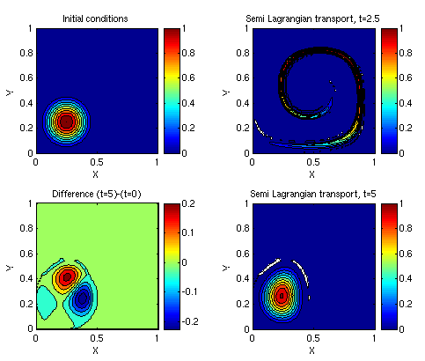
Testing the numerical core …when we don’t have an exact solution to compare to
This highlights the
problem of
numerical diffusion
Each scheme will have its own weaknesses and strengths (and conservation properties)

Slide 14
What does a numerical model need? summary
Need equations (+ parameterizations)
Output = function(input)
Need a starting point and constraints
Initial and boundary conditions
Must define time and space scales of interest
Integration time step (depends on grid choice/physics)
Spatial resolution of the grid and type of grid
Duration of model run
Decisions about time/space scales may also translate into “filtering” of the equations
(parts of the equations can be neglected and the equations simplified – some physics can be neglected/simplified)

Slide 15
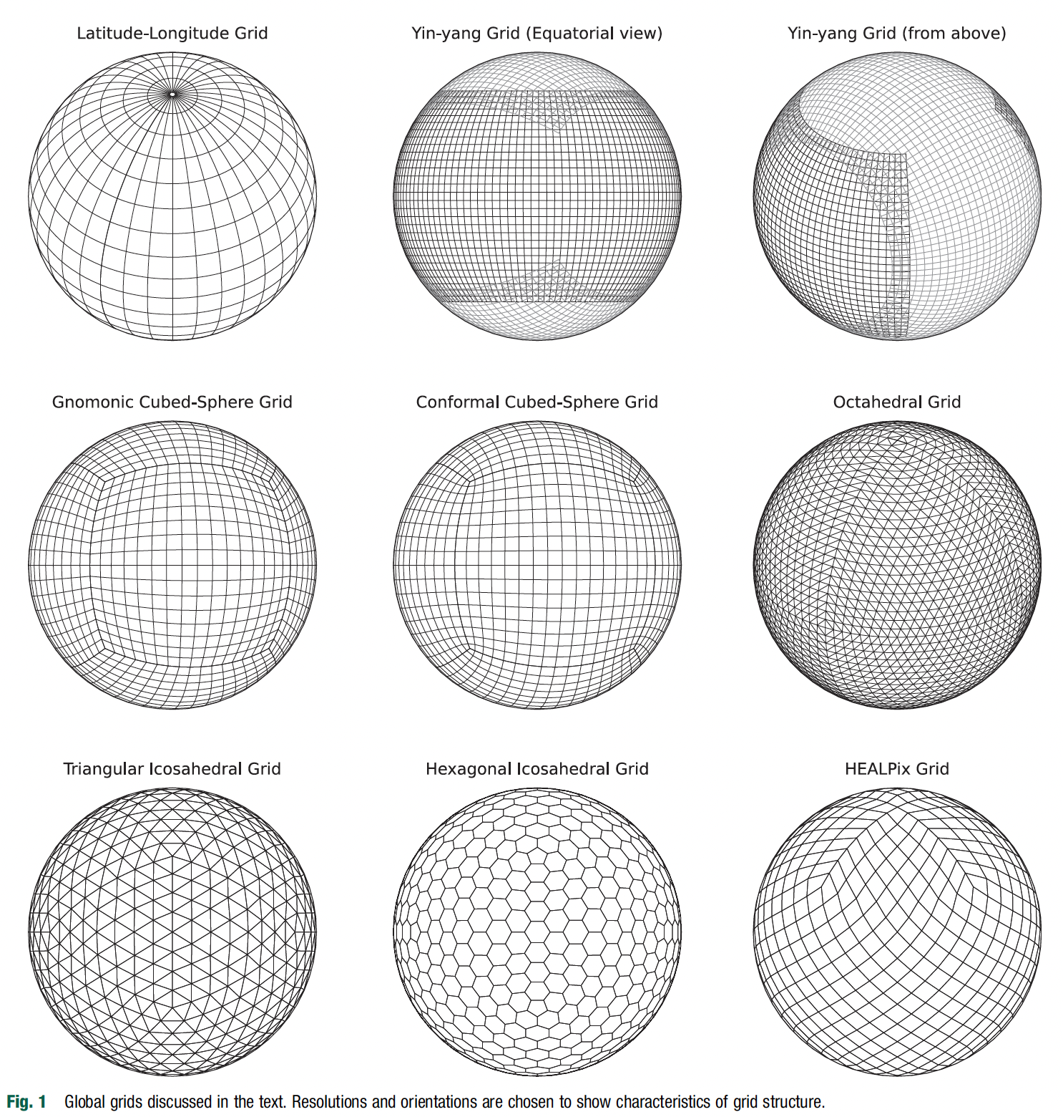
Different types of grid
Implications:
Computational stability, accuracy and cost
Post-processing
Harris 2025 https://doi.org/10.1016/B978-0-443-15748-6.00012-5

Slide 16
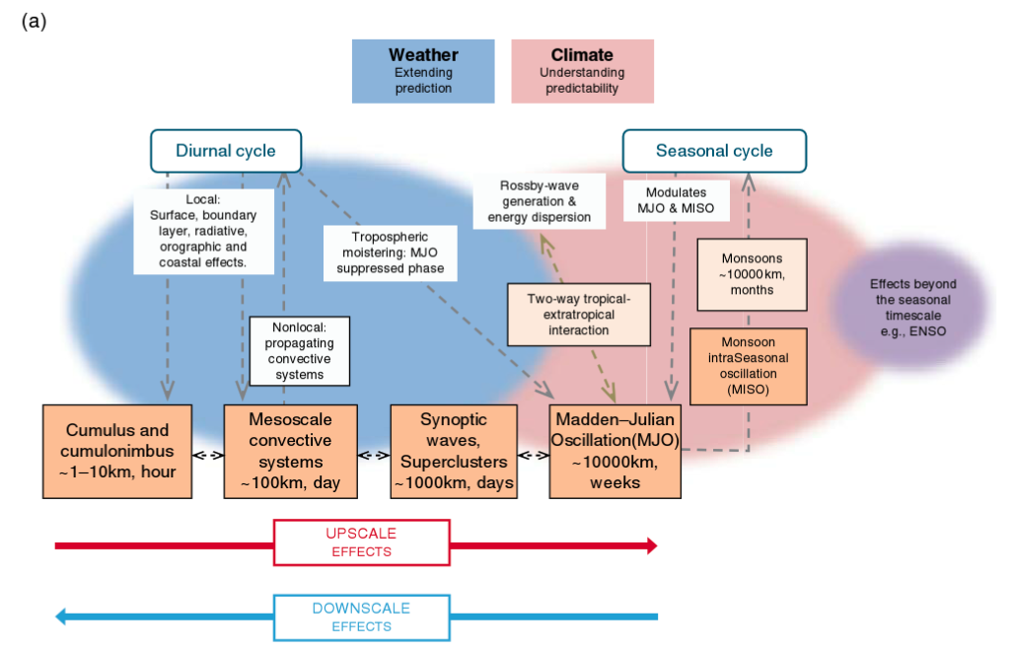
Weather and climate – bridging the gap
Numerical Weather Prediction is not the same as Climate Modelling

Slide 17
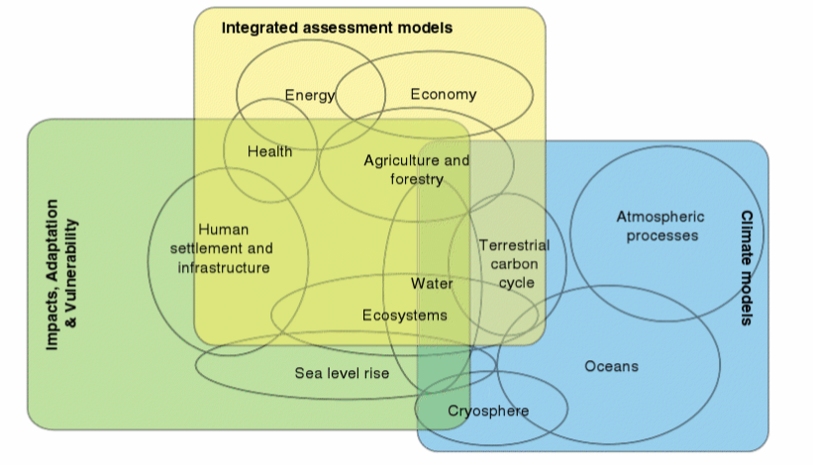
Why model climate?
Notes:
FIGURE 3.2 The landscape of the various types of climate models within a hierarchy of models is complex and overlapping. This is one view of that landscape centered on the three broad types of models and analytic frameworks in climate change research that contribute to the IPCC reports: integrated assessment models, physical climate models, and models and other approaches used to help assess impacts, adaptation, and vulnerability. SOURCE: Moss et al., 2010. Reprinted by permission from Macmillan Publishers Ltd., copyright 2010.

Slide 18
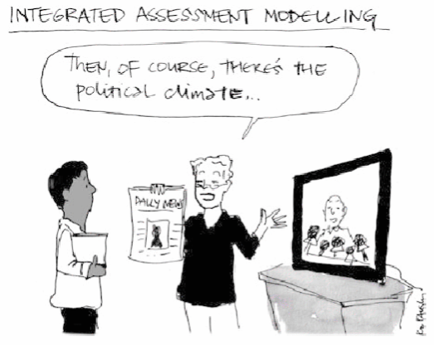

Slide 19
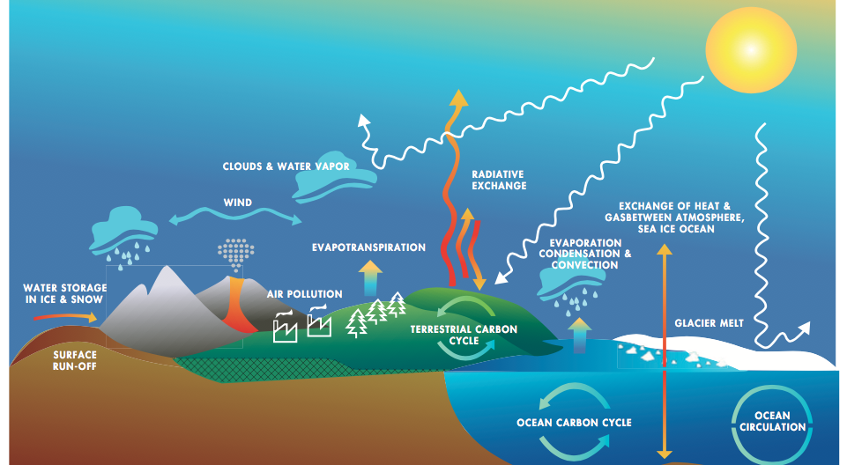
What are coupled climate models?
As complexity increases, the name is now evolving towards “Earth System Models” or “Digital Twin”
Notes:
FIGURE1.3 Climatemodelsaremathematicalrepresentationsofthephysical,chemical,andbiological processes in the Earth system. SOURCE: Marian Koshland Science Museum.

Slide 20
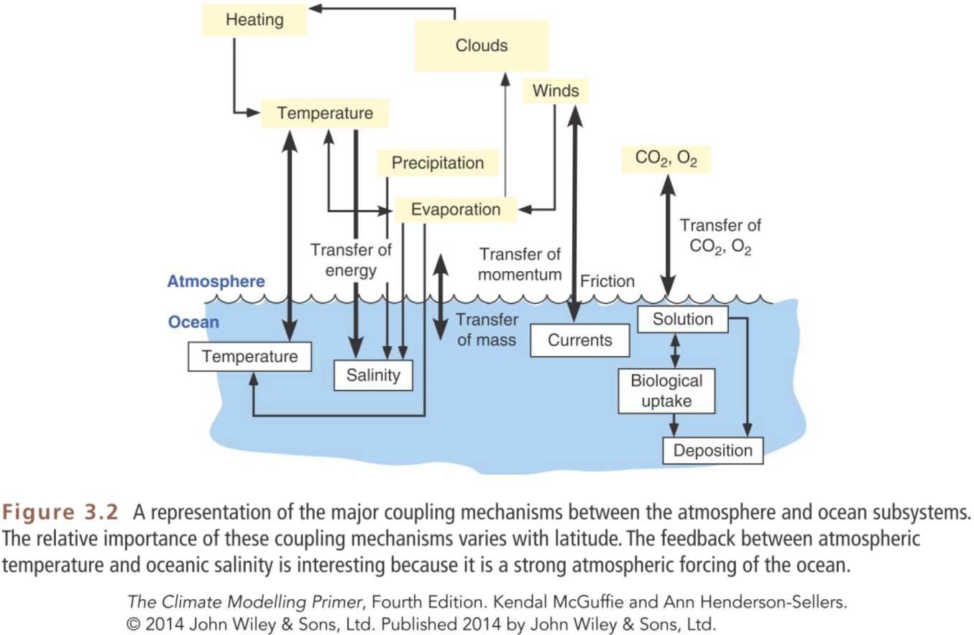
A few key major coupling mechanisms between the ocean and the atmosphere

Slide 21
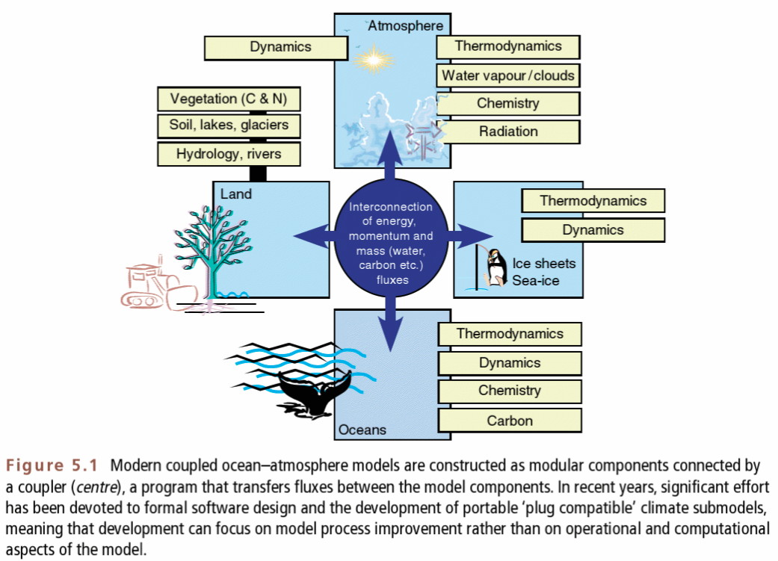
The “coupler” is the heart of climate models

Slide 22
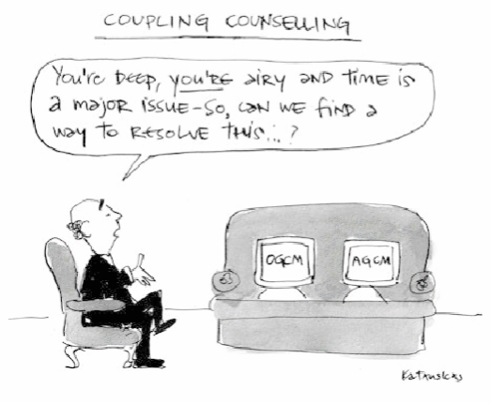

Slide 23
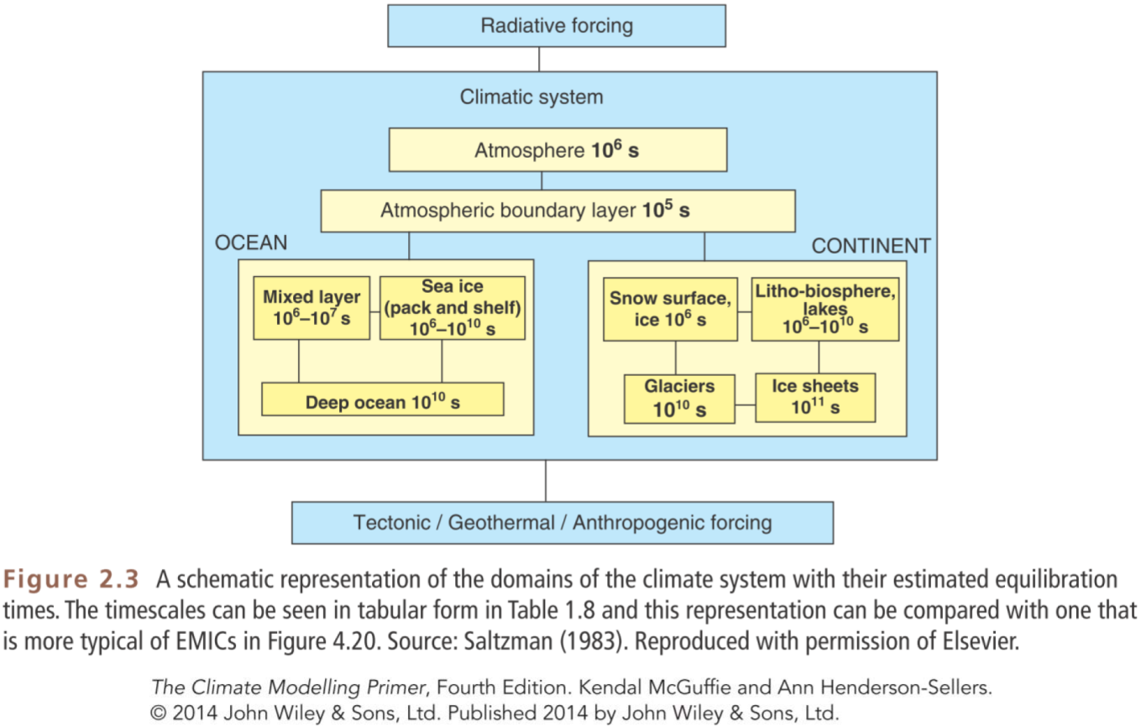
Interconnecting reservoirs with their own time-scales
(this has important numerical and computational impacts)
10⁵ s=1.5 days
10⁶ s=11 days
10⁷ s=4 months
10¹⁰ s= 300 years

Slide 24
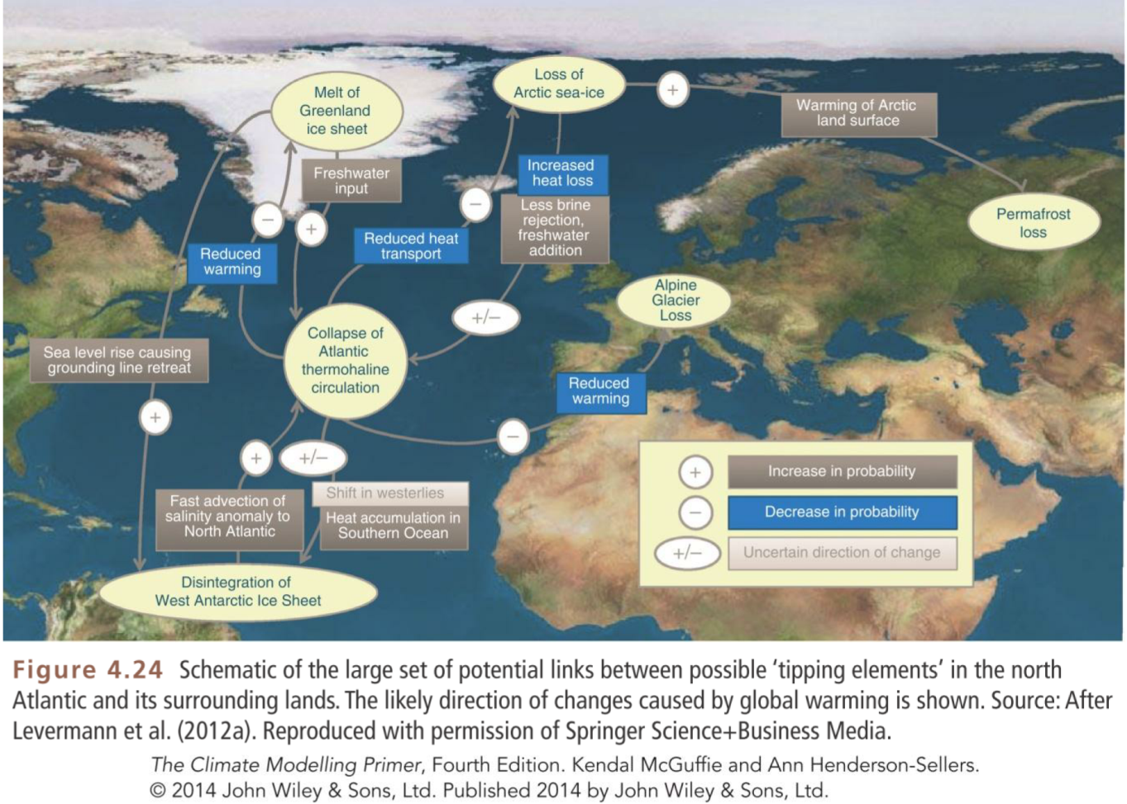
Why coupling the models in the first place?
Teleconnections and nonlinear feedbacks
Notes:
Example of main feedbacks: water vapor feedback, ice-albedo feedback

Slide 25
What is model “coupling”?
Exchanges of properties at the interfaces:
Heat
Water
Momentum
Energy
Modules are run quite independently, but regularly exchange information about each other’s states to calculate exchange fluxes
Challenges:
Grids of various modules may not match
E.g. part of an atmospheric grid box covers ocean+land+sea-ice
Properties must be conserved
Characteristic time-scales in each module differ affecting the time-step of integration needed

Slide 26
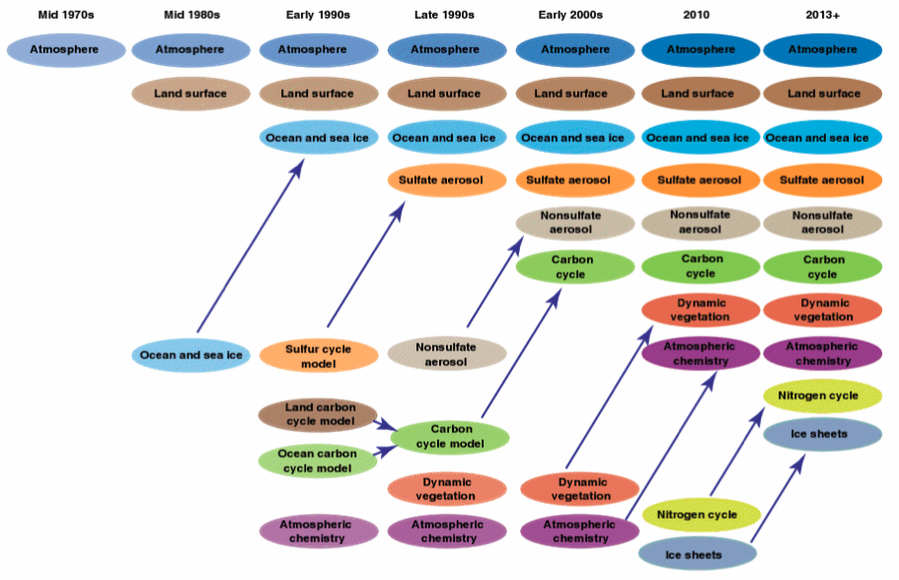
Model complexity : need vs greed and the need for speed
Notes:
From Bader et al (2008)
The climate system includes a wide range of complex processes, involving spatial and temporal scales that span many orders of magnitude. As our understanding of these processes expands, climate models need to become more complex to reflect this understanding. The balance between increased complexity and increased resolution, subject to computational limitations, represents a fundamental tension in the development of climate models.

Slide 27
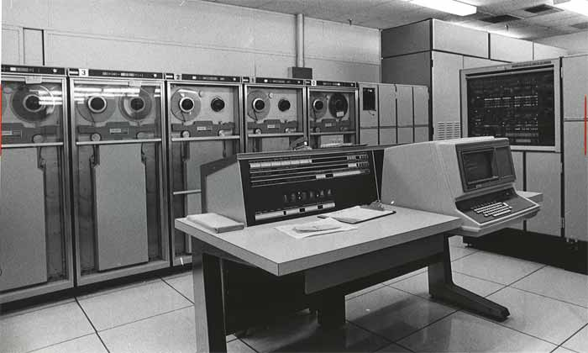
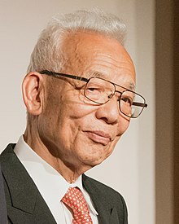
Model complexity vs resolution Late 1960s: UNIVAC 1108 (0.5MB of memory!)
Syukuro “Suki” Manabe
(Nobel prize physics 2021)
A master at simplifying problem to their essence
https://en.wikipedia.org/wiki/Syukuro_Manabe

Slide 28

The UK’ shared supercomputing facility
HPE Cray EX (28 Pflop/s)
5860 nodes x 64 core processors
=750080 cores
Nodes have 256 or 512GB of memory
High costs!
Financial
Energy
People
Data storage
Data analysis
…

Slide 29
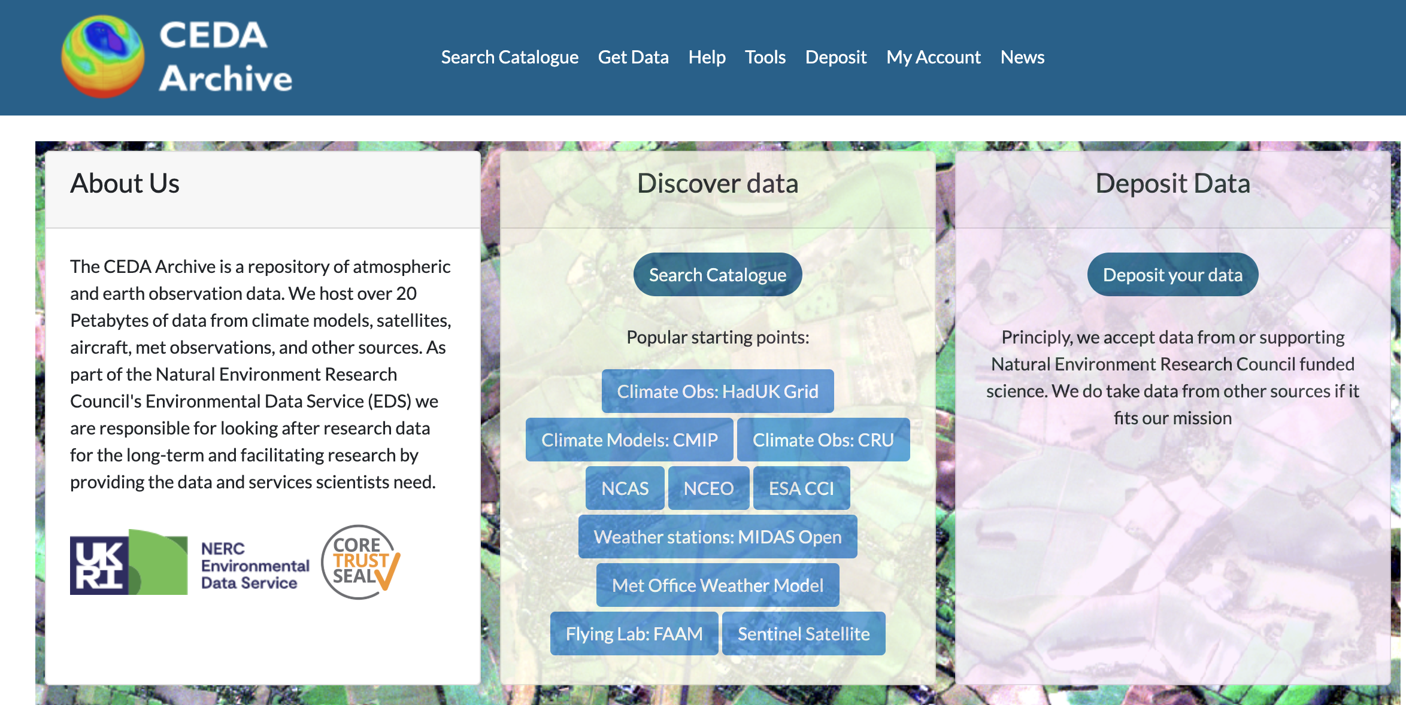
All of this requires substantial data management infrastructure
Input data
Output data
Derived or
interpreted products
Initial conditions
Boundary conditions
Observations
Model results
4D data!
(very large!)
For non-expert
‘consumers’
https://archive.ceda.ac.uk/

Slide 30
Weather AI Models
GraphCast (Google DeepMind): trained on ERA5; evaluated primarily against ERA5 analyses. (Lam et al., Science (2023): https://doi.org/10.1126/science.adi2336)
GenCast (Google DeepMind): ERA5-trained diffusion ensembles; probabilistic evaluation vs ERA5.
Pangu-Weather (Huawei): ERA5-based training and evaluation; deterministic forecasts. (Bi et al., Nature (2023): https://doi.org/10.1038/s41586-023-06185-3)
FourCastNet (NVIDIA): ERA5 training; evaluation focused on speed and ensemble skill. (Pathak et al., ICML (2022): https://doi.org/10.48550/arXiv.2202.11214)
Aardvark Weather (Cambridge/Turing): direct observation ingestion; evaluated against observations and analyses. (Keisler et al., Nature (2024): https://doi.org/10.1038/s41586-024-07034-1)

Slide 31
Climate AI Models
ClimaX: foundation model for multiple climate tasks; evaluated on downscaling and variability. (Nguyen et al., NeurIPS (2023): https://doi.org/10.48550/arXiv.2301.10343)
NeuralGCM / hybrid models: couple ML with physical cores; evaluated for stability and drift. (Kochkov et al. (2024), Nature – NeuralGCM: https://doi.org/10.1038/s41586-024-07172-6)
ML parameterisations: emulate subgrid processes; evaluated against high-resolution simulations.
AI Earth-system emulators: statistical surrogates for ESMs; evaluated on climatology and extremes.

